Slide 1
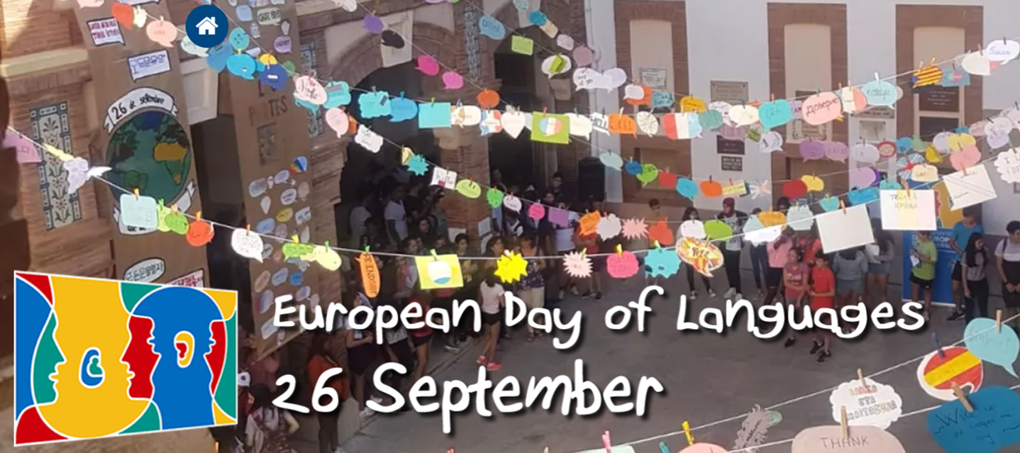
Year 7
Competition
Draw, paint, make, sew, build or create some bunting!
It must have European countries’ flags.
It must be colourful.
It must be your BEST work.
Think big and win big – prizes on offer!
We can’t wait to see your ideas! Deadline: Friday 17^{h} September

Slide 2
Year 8
Competition
Write and decorate ‘Hello’ in a European language!
It must be European country.
It must be colourful.
It must be your BEST work.
Think big and win big – prizes on offer!
We can’t wait to see your ideas Deadline: Friday 17^{h} September

Slide 3
Year 9
Competition
Draw, paint, make, sew, build or create a flag!
It must be a European country.
It must be colourful.
It must be your BEST work.
Think big and win big – prizes on offer!
Could you make bunting, a real flag, a poster? We can’t wait to see your ideas!
Deadline: Friday 17th September

