Slide 1
Horizon Community College Student Bulletin
Wednesday 29th March 2023
School Ready; Work Ready; Life Ready

Slide 2
March focus - Teamwork
During March, staff will reward achievement points for students demonstrating
our core value – Teamwork.

Slide 3
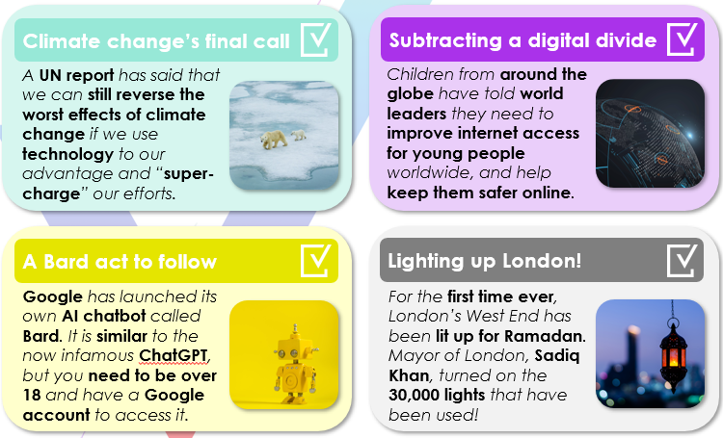
In the news this week

Slide 4
#HCCREADS
Mrs Hardcastle Recommends...
It beautifully writes about a child's perception of a tragedy that they are living in - they cannot comprehend the illness that their mother is suffering from and their response to this, so they manifest their grief in the form of a monster.

Slide 5
Sawm is one of the pillars of Islam. This is the Muslim duty to fast during the Islamic month of Ramadan.
This year, Ramadan begins in the UK on Thursday 23rd March. From this day, Muslims will fast (not eat or drink) during the daylight hours. During this month, Muslims may also spend more time at the Mosque, read the Qur’an more, or perform more prayers.
Many Muslims will also avoid some of life’s luxuries e.g. wearing make-up or listening to music.
As a College, we can support our Muslim students/staff by educating ourselves about Ramadan and the Islamic faith, and being sensitive to their requirements. You should also not offer them food/drink out of consideration and respect.
Why do Muslims take part?
It is one of the Five Pillars of Islam, meaning it is a duty.
The Qur’an states that “fasting is prescribed to you”.
To understand how the poor feel and show sympathy (then make a donation to charity after Ramadan is over).

Slide 6
Fundraising Friday
Total Update:
£211 from the sale of buns and biscuits
£270.47 loose change and raffle
£1400 so far from the Danceathon
A huge thank you!

Slide 7
Horizon Litter Pick – Thursday lunchtime
Tomorrow lunchtime we will be tidying up the college site and therefore taking part in the 'Great British Spring Clean'
It's simple, at lunchtime you can support by collecting a litter picker and working with staff to tidy up our site.
Members of the eco-group and student council will be going out into the community during the morning to tidy up our local area.
How many bags of rubbish can we collectively fill?
Our individual actions can have a huge impact.
This is the total amount of litter across the country that has so far been pledged to be cleaned up.

Slide 9
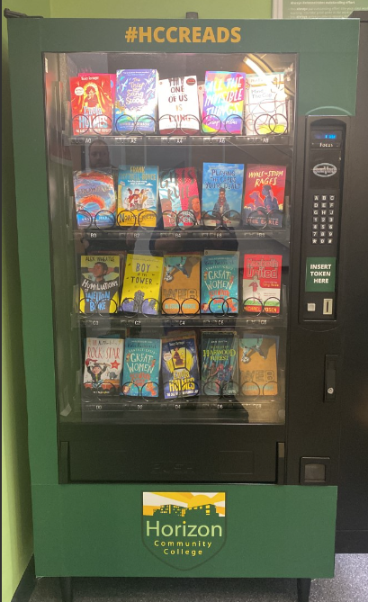
Reading Rewards
Tokens are awarded every time you achieve 5 positive conduct points and for completing a reading journey card. The book is yours to keep!
5 Positive Conduct Points
Your form tutor will be informed weekly and they will note in your planner.
Tokens can be collected from the library, before school, at lunch or at the end of the day. Head to your year groups section of this bulletin to see who has achieved a token this week!
Reading Journey Cards
For each book you read...​​ | Your teacher/the Librarian will give you 5 achievement points. ​​
When you've completed your card...​​ | Bring it to the Library to receive a certificate and a token for the vending machine. ​
If you complete anothercard...​​ | Bring it to the Library area to receive a certificate, a phone call home and a token / free book!​​
In your planner!

Slide 10
Home Learning 2022/23
Example of retrieval: Mindmap (2 mins 33)
Direct stream link: click here

Slide 11
MFL Staff Shoutouts for excellence in home learning in MFL for the week commencing the 20.03.2023.
 | Mrs Stone | Mrs Eddy | Ms Davies | Mrs Gilmartin | Miss Ost | Mrs Smallman | Miss Taylor
Year 7 |  | Alfie H******** | Nithiesh S*********** | Bertina S***** | Felicity V******* |  | Izzy L*****
Year 8 |  |  | Oliver J****** | Jake F**** | Lilly F******* |  | Leah H*******
Year 9 |  | Amber B**** | Soraia P***** | Liam O*** | Isable H**** |  | Will C***
Year 10 |  | Isabella M****** | Mia R***** | Isobel V***** | Katie S******* | Pola P***** | Logan R*****
Year 11 |  | Chloe S***** |  | Holly S******* | Amelia J**** |  | Frederick E*******

Slide 12
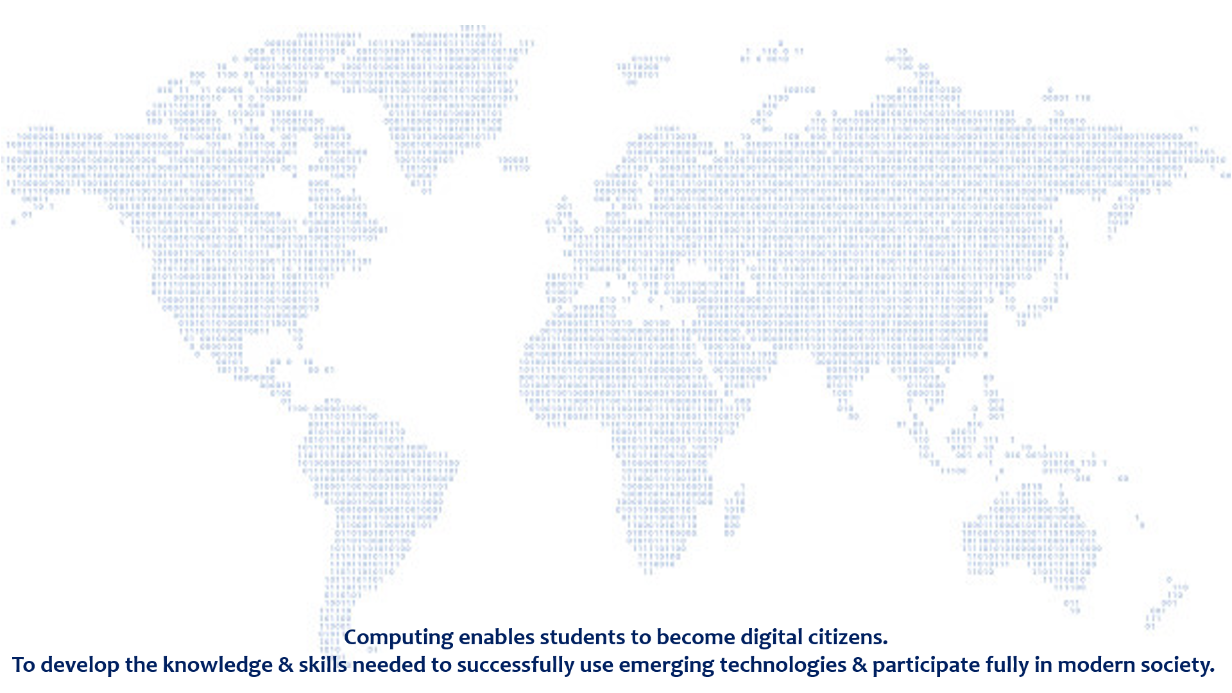
BE SAFE ONLINE #11
Be careful what you download
A top goal of cybercriminals is to trick you into downloading malware. Malware might be disguised as an app: anything from a popular game to something that checks traffic or the weather or it could be hidden on a malicious website.
Malware causes damage – such as disrupting how your device operates, stealing your personal data, or allowing unauthorized access to your machine.
This usually requires some action on your part, but there are also drive-by downloads, where a website attempts to install software on your computer without asking for permission first.
Think carefully before downloading anything onto your device, and only download content from trusted or official sources.
Key online dangers:
Identity theft
Data breaches
Malware & viruses
Phishing & scam emails
Fake websites
Online scams
Inappropriate content
Cyberbullying
Faulty privacy settings

Slide 13
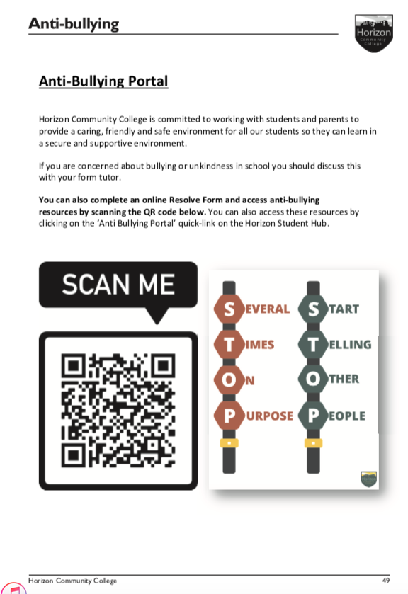
Anti-Bullying – Be Kind, Take Action
On Page 49 of your student planner you will find a QR Code, this will allow you to report bullying. You can also report on behalf of a friend or even just someone you see around school and you hear people being unkind to.
The pages before this also contain guidance on what bullying is and other places you can find support.
Do not be a bystander; take action against bullying to ensure Horizon is a safe and enjoyable place to learn for all.
Several Times On Purpose Start Telling Other People

Slide 14
Y9, Y10 & Y11 Careers and Enterprise
Team Based in 10.01
Ms Harrison, Ms Middleton, Mrs Mawer and Mrs Daykin.
Here to help, advise and support all the way through your Horizon journey.
Whether you know what you want to do or have no idea we can link you to employers and businesses.
Visit us in the Careers Café at Lunch.
Student Hub – Lots of Information about Careers
Student Hub - Start Exploring Now

Slide 15
Jump to…
Year 7
Year 8
Year 9
Year 10
Year 11

Slide 16
Year 7
Your form tutor will support you throughout the year.
Year 7 Team
Assistant Principal - Head of KS3 Pastoral | Mrs Sheldon
Assistant Principal – Deputy Head of KS3 Pastoral | Mr Middleton
Head of Year Deputy Head of Year | Mrs Robinson Mr Mills
Student Wellbeing | Mrs White

Slide 17
#HCCREADS
Alex S
Alfie K
Alfie M
Ali A
Amelia K
Amelia M
Amy S
Ash H
Ben L
Bradley E
Caleb S
Catalina B
Connor B
Courtney T
Dexter C
Elise W
Fifi O
Harriet J
Isabel G
Jacob D
Jacob L
Jacob Y
Jessica T
Joe M
Joel Z
Jonny B
Lacey P
Liliana J
Lilly H
Lucie C
Lucie N
Lucy B
Max L
Millie T
Olivia M
Pheobie L
Phoebe T
Ruby A
Ruby A
Scott Ba
Seth R
Simon S
Skylar A
Year 7:
Well done on achieving your fifth positive conduct point. If your name is on this list, please go to the library to collect your book token.

Slide 18
Term 2

Slide 19
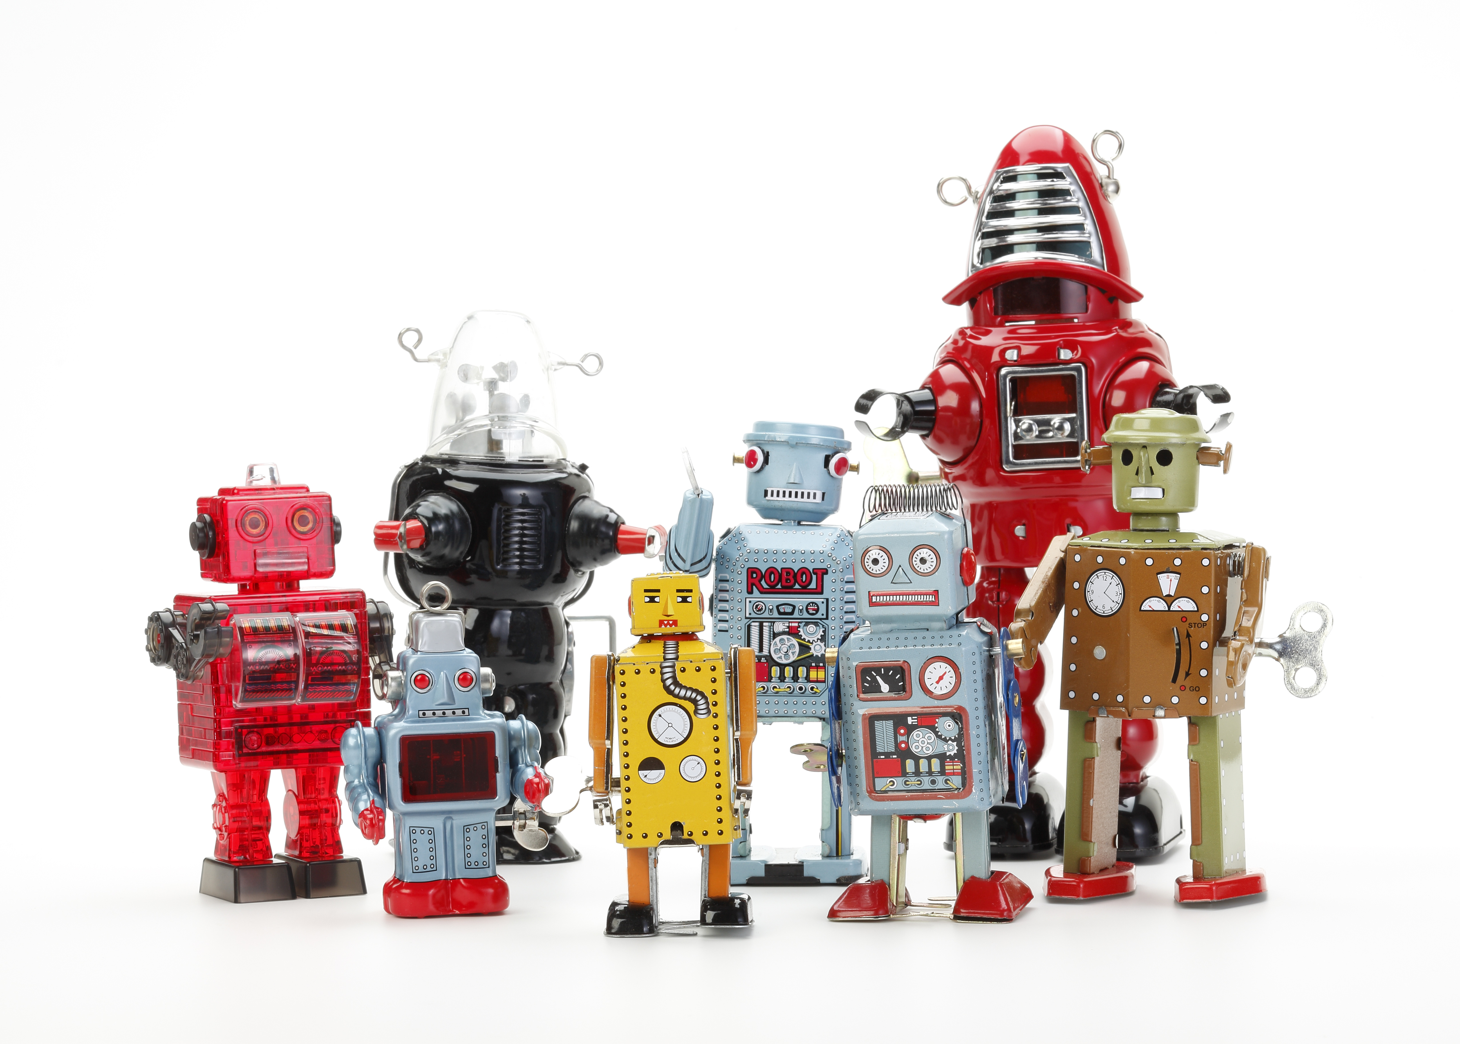
Interview an Adult
You will receive an email link to a Microsoft form – THIS WEEK.
OVER EASTER - Use the form and the questions to ask a grown up about their job and how they got there
Parent/Carer/Family Friend/Teacher
Reply to the questionnaire – GOOD LUCK
Forms and help available from the Careers Team

Slide 20
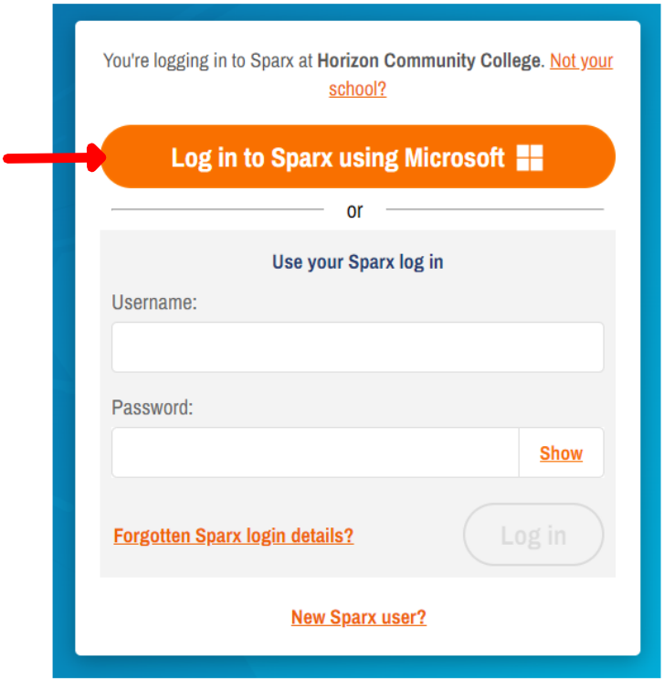
Sparx Log Ins
From now on you can log in to Sparx using your school Microsoft account
(same as your emails, teams, student hub etc)

Slide 21
Sparx Homework Club – ICT 8
From Monday 17th April Miss Baker will be hosting Sparx club to support with any homework needs (ALL years are welcome)

Slide 22
Year 8
Your form tutor will support you throughout the year.
Year 8 Team
Assistant Principal - Head of KS3 Pastoral | Mrs Sheldon
Assistant Principal – Deputy Head of KS 3 Pastoral | Mr Middleton
Head of Year | Mr Cousins
Student Wellbeing | Mrs Woodcock

Slide 23
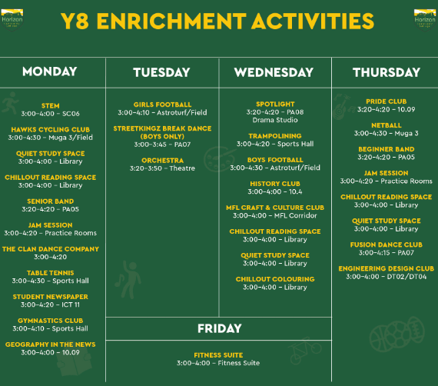
Term 2

Slide 24
#HCCREADS
Alex L
Alys C
Andrei G
Annie P
Beau B
Callum B
Daisy B
Darius F
David S
Dimosthenis M
Ella-Rose O
Georgia H
Isobel G
Jack H
Joshua S
Kaiden B
Kelsey B
King I
Leah H
Leah S
Lexie C
Libbie M
Libby R
Lilly B
Livvy G
Mercedes W
Owen
Owen A
Sarah S
Year 8:
Well done on achieving your fifth positive conduct point. If your name is on this list, please go to the library to collect your book token.

Slide 25
Sparx Log Ins
From now on you can log in to Sparx using your school Microsoft account
(same as your emails, teams, student hub etc)

Slide 26
Year 9
Your form tutor will support you throughout the year.
Year 9 Team
Assistant Principal - Head of KS3 Pastoral | Mrs Sheldon
Assistant Principal – Deputy Head of KS 3 Pastoral | Mr Middleton
Head of Year | Mr Trainer
Student Wellbeing | Ms Gibson

Slide 27
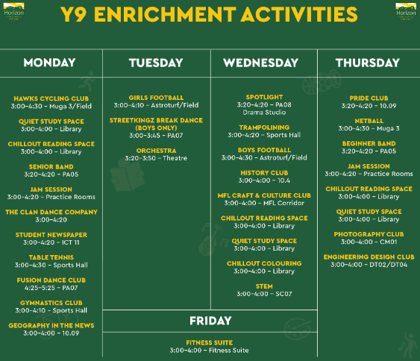
Term 2

Slide 28
#HCCREADS
Agata B
Alexander F
Amber W
Antonina B
Beau L
Beau L
Bethany K
Connor R
Destiny B
Eden C
Eden P
Elizabeth G
Emily A
Emily D
Enya H
Ethan T
George K
Grace F
Grace K
Grace L
Imogen B
Isabelle H
Jacek W
James W
Joe C
Kalina W
Kiara S
Lacey G
Lillian F
Lily B
Lucas B
Luke M
Lyden S
Malaika C
Muntaha J
Nathan M
Noah L
Ray C
Reuben J
Seth L
Shelby P
Shelley C
Sophia T
Year 9:
Well done on achieving your fifth positive conduct point. If your name is on this list, please go to the library to collect your book token.

Slide 29
Sparx Log Ins
From now on you can log in to Sparx using your school Microsoft account
(same as your emails, teams, student hub etc)

Slide 30
Year 10
Your form tutor will support you throughout the year.
Year 10 Team
Assistant Principal – Head of KS 4 Pastoral | Mr Plant
Head of Year | Mrs Heskett
Student Wellbeing | Mrs Wilson Miss Fox

Slide 31
#HCCREADS
Alexis S
Amy C
Amy J
Anya B
Brooke W
Cobi G
Emily P
Frankie T
Grace H
Holly W
Kian H
Landon A
Liam S
Libby L
Lilia H
Maisie F
Megan N
Olivier K​
Ronan M
Sander O
Sofiia S
Stephanie H
Year 10 / 11:
Well done on achieving your fifth positive conduct point. If your name is on this list, please go to the library to collect your book token.

Slide 32
Term 2

Slide 33
Sparx Log Ins
From now on you can log in to Sparx using your school Microsoft account
(same as your emails, teams, student hub etc)

Slide 34
Year 11
Your form tutor will support you throughout the year.
Year 11 Team
Assistant Principal – Head of KS4 Pastoral | Mr Plant
Head of Year | Mr Reilly
Student Wellbeing | Mrs Wilson Miss Fox

Slide 35
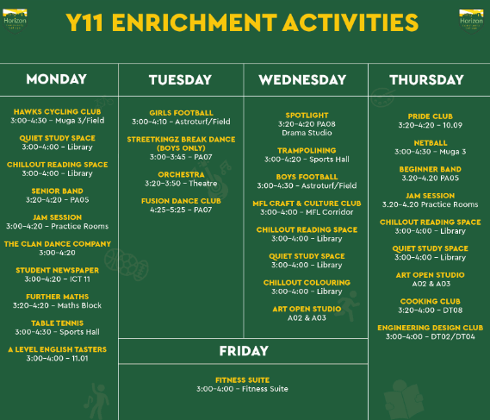

Slide 36
#HCCREADS
Alexis S
Amy C
Amy J
Anya B
Brooke W
Cobi G
Emily P
Frankie T
Grace H
Holly W
Kian H
Landon A
Liam S
Libby L
Lilia H
Maisie F
Megan N
Olivier K​
Ronan M
Sander O
Sofiia S
Stephanie H
Year 10 / 11:
Well done on achieving your fifth positive conduct point. If your name is on this list, please go to the library to collect your book token.

Slide 37
Year 11 Diary and exam support 2022/23
English Language Paper 2 – Question 2 (3 mins 7)
Direct stream link: click here

